Slide 1
Unit 3
Review
My house p.g24-25

Slide 2

The cat in the box.

Slide 3
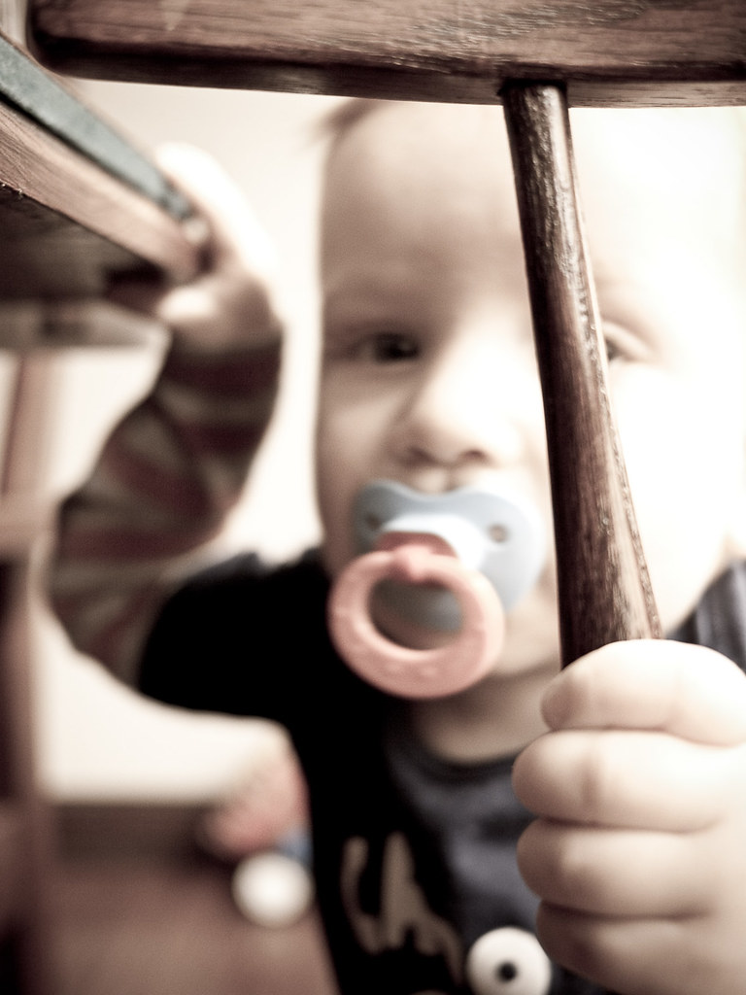
The baby is under the table.
This Photo by Unknown author is licensed under CC BY-NC.

